Slide 1
ECE 105: Introduction to Electrical Engineering
Lecture 3
Circuit analysis 1
Yasser Khan
Rehan Kapadia

Slide 2


Basic circuit quantities
Quantity | Symbol | Units
Voltage | V | Volts (V)
Current | I | Amperes (A)
Resistance | R | Ohms (Ω)
Capacitance | C | Coulomb (C)
Inductance | L | Henry (H)

Slide 3
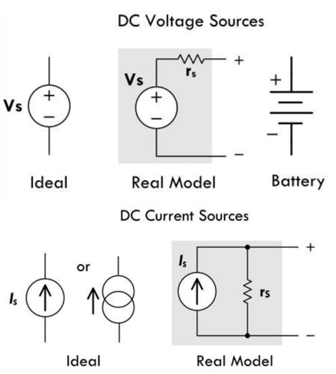



Notations

Slide 4
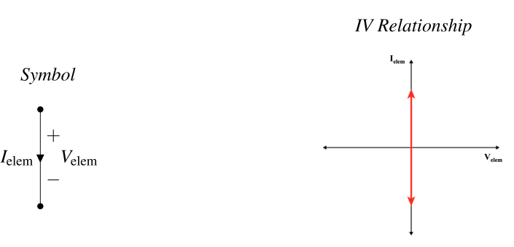
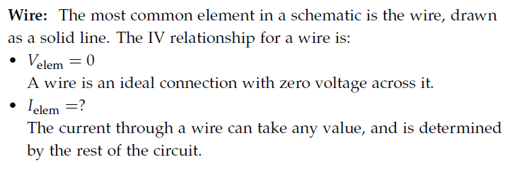
Wire

Slide 5
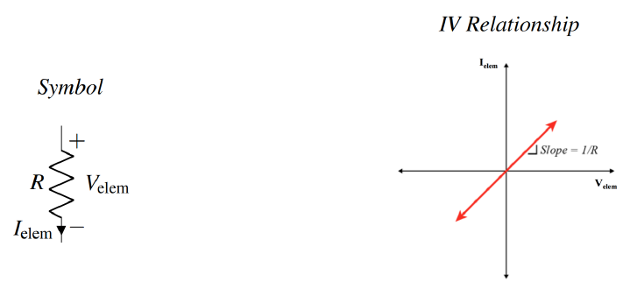

Resistor

Slide 6
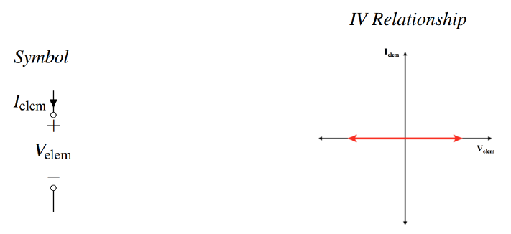

Open circuit

Slide 7
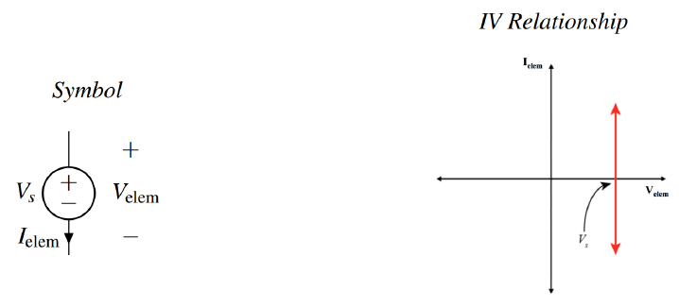
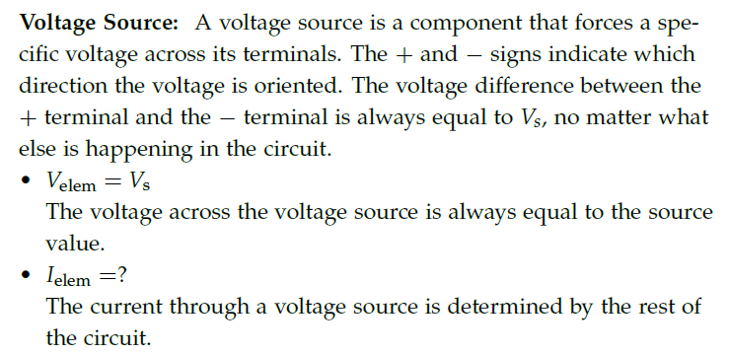
Voltage source

Slide 8
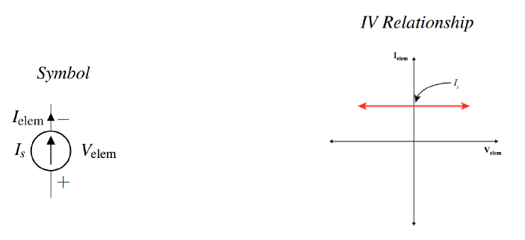
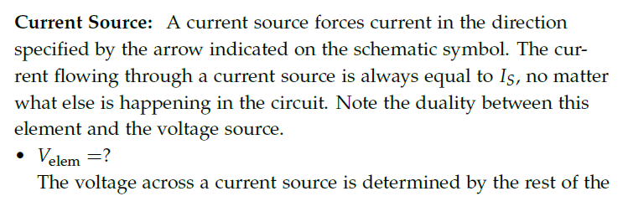

Current source

Slide 9
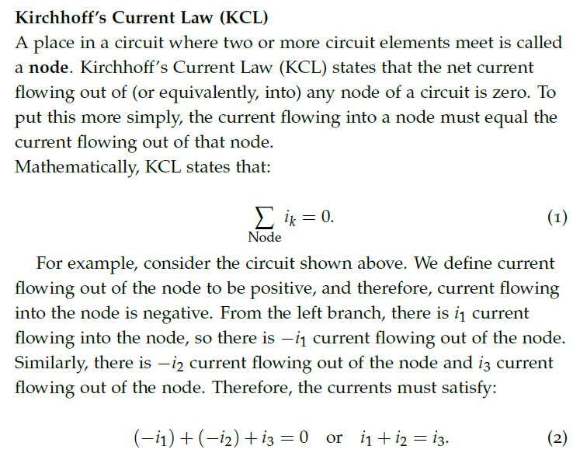
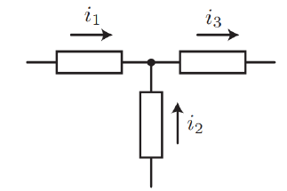




Rule of circuit analysis - KCL

Slide 10

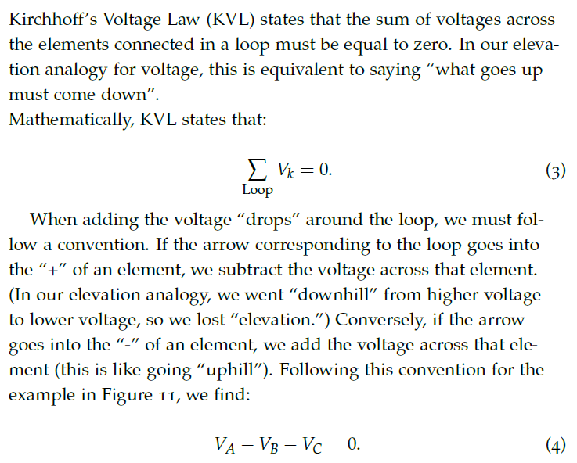
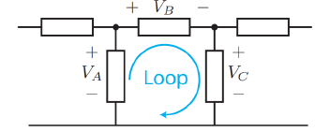

Rule of circuit analysis - KVL

Slide 11
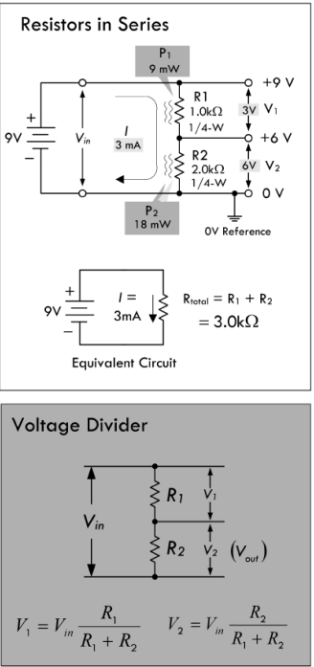
Resistors in series

Slide 12
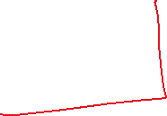
Voltage divider

Slide 13
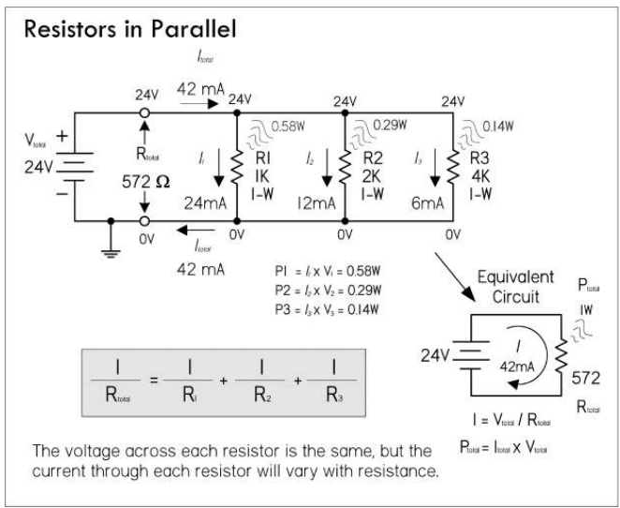
Resistors in parallel

Slide 14
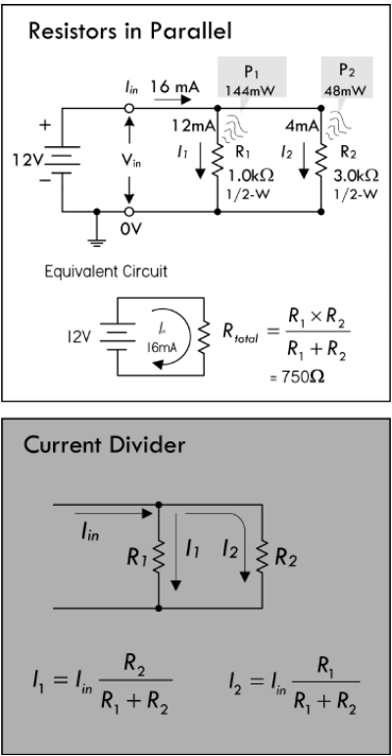








Current divider

Slide 15





Measuring voltage, current, resistance

Slide 16
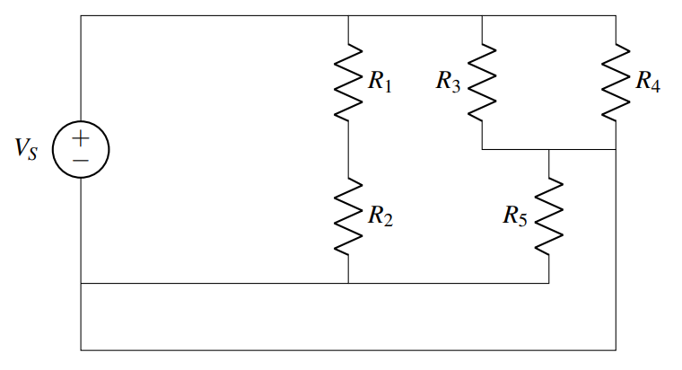
Finding nodes

Slide 17
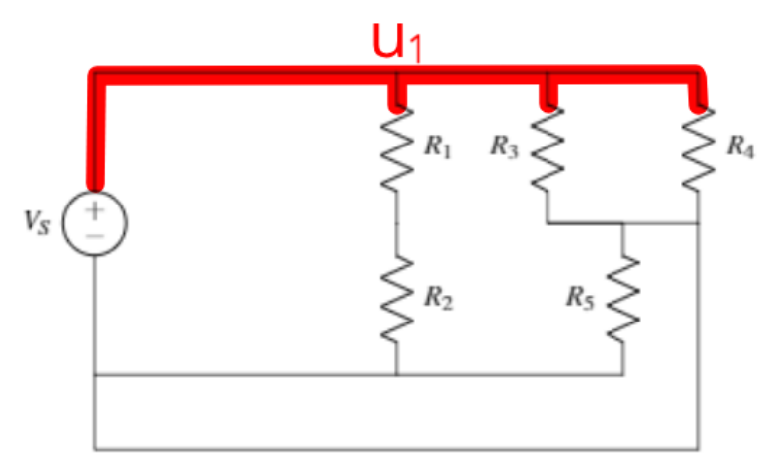



Find the node connected to the source

Slide 18
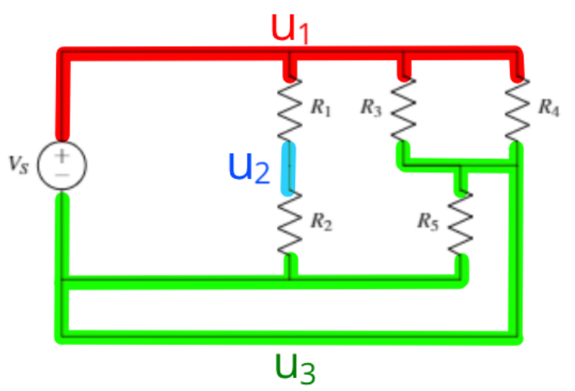


Find other nodes

Slide 19
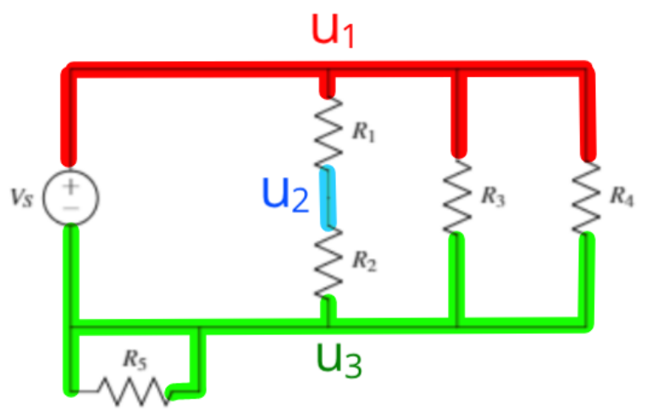




Merge elements sharing the same nodes

Slide 20
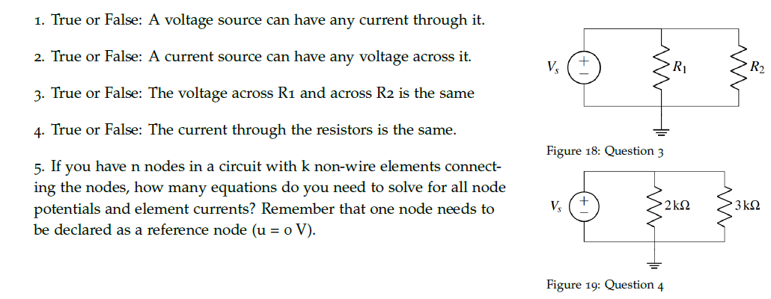





Practice problems

Slide 21

Practice problems

Slide 22
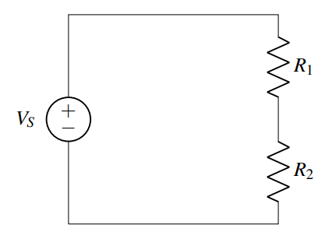


Practice

Slide 23
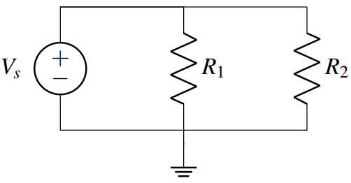
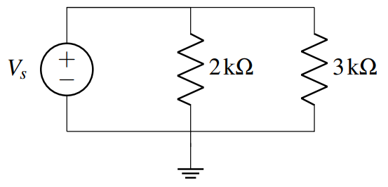



Practice

Slide 24




Fuse

